Slide 1

PROGRAMMING FUNDAMENTAL LAB
Brew Haven: Café Management System
A simple desktop app made in Python 3 with PyQt5. It helps manage a café in real time.
Prepared and submitted by Zainab Sohail, Roll No. 76.

Slide 2
System Overview
Simple Desktop Design
The Brew Haven Cafe Management System helps run a café easily. It is made for the Programming Fundamental Lab project and keeps tasks organized.
The app separates the screen from background work so it stays fast, easy to use, and keeps data safe.
Async Signals
Financial Logic
Safe DB Ops
Quick updates without slowing the app
Simple automatic calculations
Secure storage for records

Slide 3



Project Structure
Easy Structure and Safe Data
This project focuses on clear structure, safe data handling, and keeping information steady. It helps users make choices, calculate taxes, and save data for later use.
1
2
3
Simple UI Control
Money Calculations
Saved Data
Turns .ui files into Python code without layout problems.
Stores sales records safely in local files.
Handles real-time changes based on user choices.
4
Live Progress
Uses timers to show smooth, non-blocking updates.

Slide 4
Screen Layout and Logic
Five Simple Screens
Brew Haven keeps the app's screen layout separate from its data. The app uses one main window and moves through 5 simple screens in order.
Index 0 — Welcome
Index 2 — Order
Index 4 — Countdown
Shows the brand, basic info, and a button to get started.
Shows the current order and suggests extra items.
Shows a live countdown and order status updates.
1
2
3
4
5
Index 1 — Menu
Index 3 — Bill
Shows the menu, prices, and buttons to adjust items.
Shows the bill with the total, tax, and service fee.

Slide 5
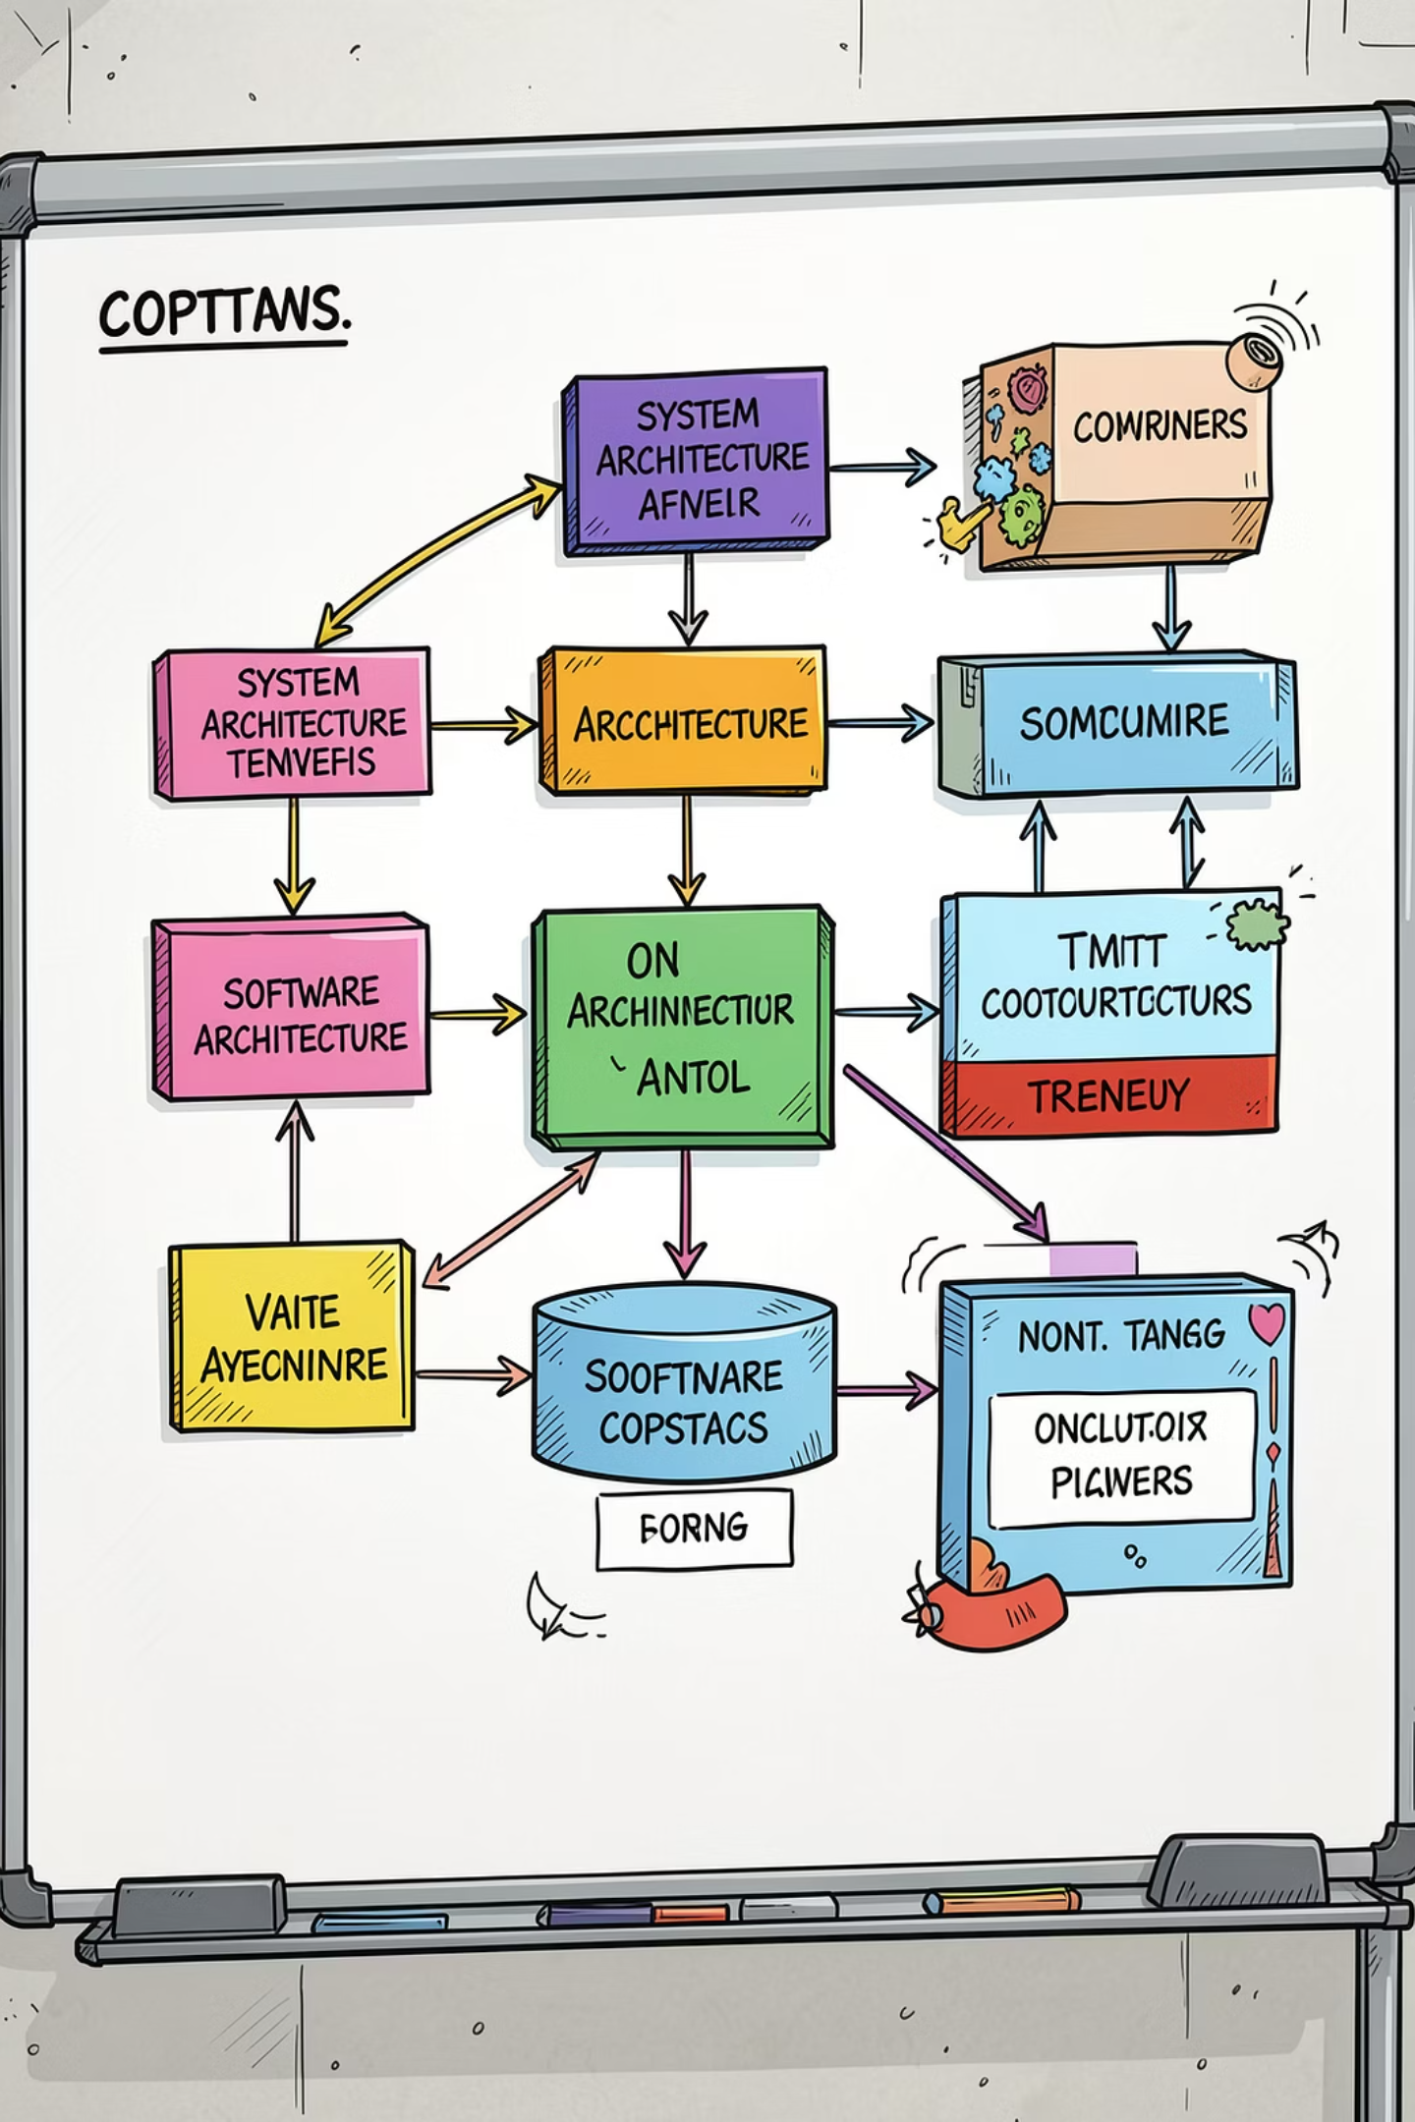

System Flow
How Information Moves
This diagram shows how the app moves through five steps: welcome, menu, order, billing, and finish. It also shows how each step keeps its own data clear and separate.
Welcome
Menu
Check
Bill
Each step passes data along in a clean way, so one part does not mix up with another.

Slide 6
Pricing and Totals
Automatic Price Calculation
The system updates prices automatically. It adds tax and service fees using simple formulas.
Core Formulas
Subtotal = item price × quantity
The system adds 5% tax and a 10% service fee to the subtotal. It updates the total right away as items change.
Tax (5%) = subtotal × 0.05
Service fee (10%) = subtotal × 0.10
Grand total = subtotal + tax + service fee

Slide 7
Database Design
Using SQLite for Storage
The data is stored in SQLite, a simple built-in database. It helps avoid write delays and keeps data safe
when many orders come in at once.
Field
Type
Rules
What it does
order_id
INTEGER
PRIMARY KEY AUTOINCREMENT
Gives each order its own unique number.
timestamp
DATETIME
DEFAULT CURRENT_TIMESTAMP
Saves the date and time of each order.
items_summary
TEXT
NOT NULL
Saves a short text list of the items.
subtotal
REAL
NOT NULL
Saves the total before tax.
tax
REAL
NOT NULL
Saves the tax amount.
service_charge
REAL
NOT NULL
Saves the service fee.
grand_total
REAL
NOT NULL
Saves the final amount due.

Slide 8
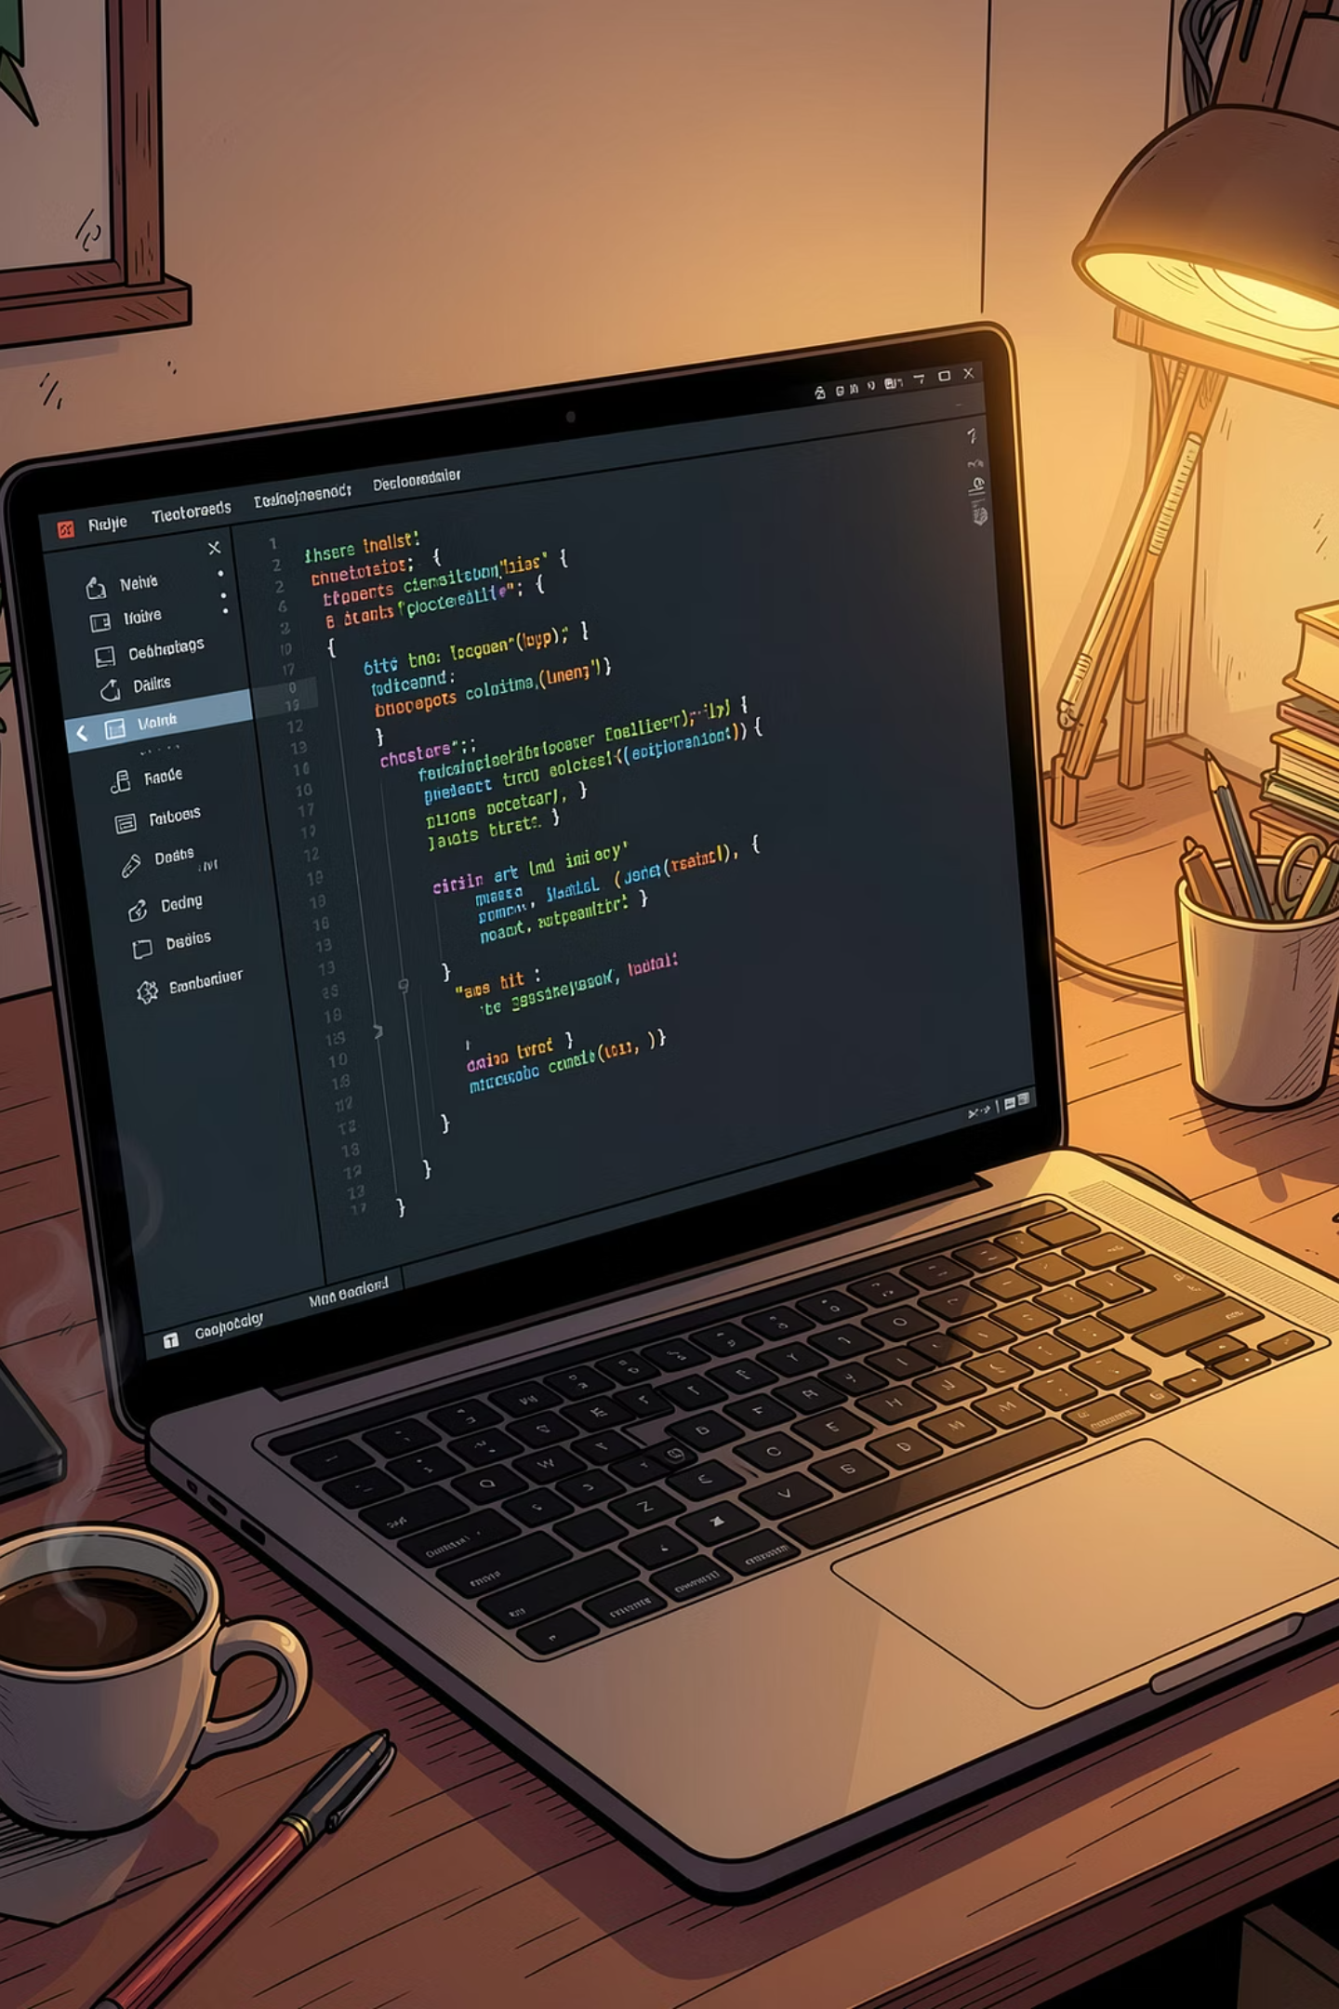
Code Setup
Main Program File
This main.py file sets up the app, connects to the database, and handles the main screen. It also keeps track of prices, taxes, and service fees.
import sys, os, sqlite3
from PyQt5 import uic
from PyQt5.QtWidgets import QApplication, QMainWindow, QAbstractSpinBox
from PyQt5.QtCore import QTimer, Qt
PRICES = {"Coffee": 250, "Tea": 150, "Burger": 500,
"Sandwhich": 250, "Fries": 300, "Pizza": 1200}
TAX_RATE, SERVICE_RATE = 0.05, 0.10
class BrewHaven(QMainWindow):
def __init__(self):
super().__init__()
uic.loadUi("cafe management.ui", self)
# Connect buttons and other actions here...

Slide 9

Testing
Test Results
We ran a set of tests to make sure the system gave correct results in real use.
Zero Input Check
1 Pizza Test
Live Update Test
The system stops you from moving forward when nothing is entered. It also warns the user and keeps the cursor in place.
Subtotal: Rs. 1200, Tax (5%): Rs. 60, Grand Total: Rs. 1380. The system updates the receipt and saves the log correctly.
When values change, the screen updates right away. The system responds quickly with no delay.

Slide 10

Results and Future Work
Simple Working Desktop App
The Brew Haven project meets the main goals of the programming lab. It shows a clean desktop app with custom screens, simple button logic, and saved data.
5
UI States
Five screen views
6
Menu Items
Six price items
7
DB Fields
Seven saved fields
3
Test Scenarios
Three checks passed

